Slide 1
Poe: Gothic and Allegory

Slide 2
19th Century Romanticism
After the “Age of Reason” came to an end, the people of America were tired of reality; they wanted to see life as more than it was.
This was the Era of Romantics. The main medium that presented itself at that time were short stories, poems, and novels.
Imagination dominated; intuition ruled over fact.
Gothic literature was also introduced at this time, which is a sub-genre of Romanticism:
This genre included stories about characters that had both good and evil traits.
Use of supernatural elements.

Slide 3
Gothic Characteristics
Fascination for the past, particularly the medieval era
Liking for the strangely eccentric, supernatural, the magical, the sublime, intermingled with the realistic
Representation and stimulation of fear, horror, the macabre and sinister
Exotic settings
Plot within plots, sometimes with multiple narrators

Slide 4
Elements of Gothic Writing
Emphasis on setting
  Exterior: landscape
  Interior: houses
Castle-like architecture
Characters are brooding, secretive
Buried family secrets
Long history of family tied to place

Slide 5
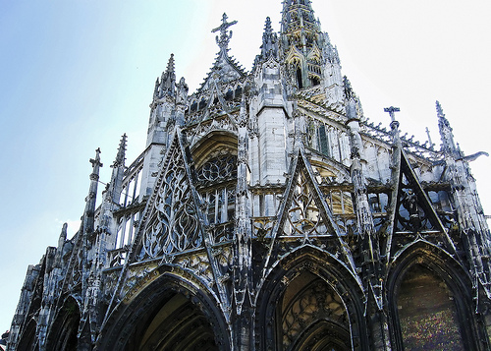
Gothic Architecture
Used mostly in cathedrals and churches across Europe in medieval times. 12th-16th centuries.
Neo-Gothic revival during the 18th century.

Slide 6
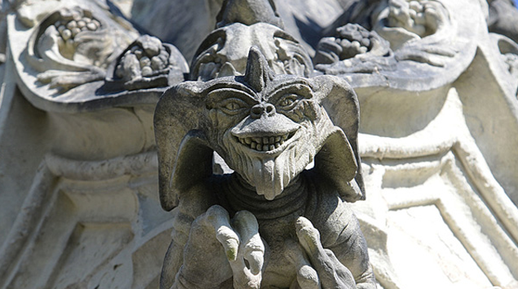
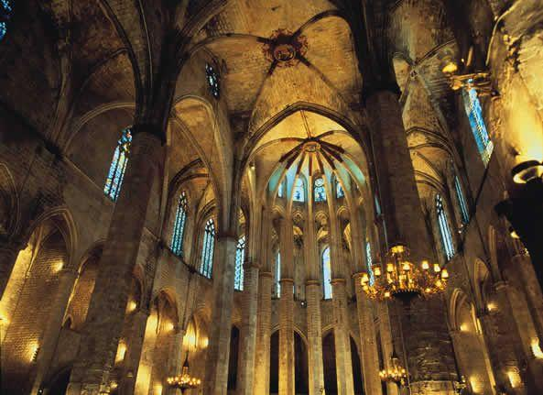
Gothic Architecture

Slide 7
What are some books and movies you can think of that fit this description?

Slide 8
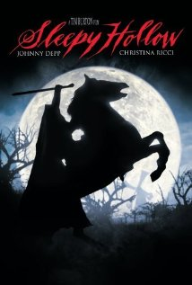
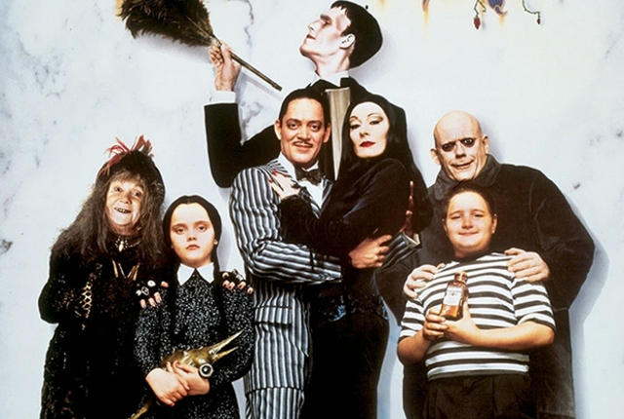
Movies: Anything by Tim Burton
Sleepy Hallow
Addam’s Family

Slide 9
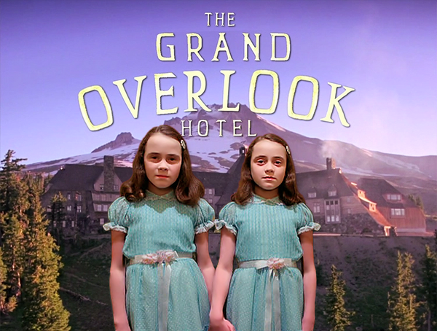
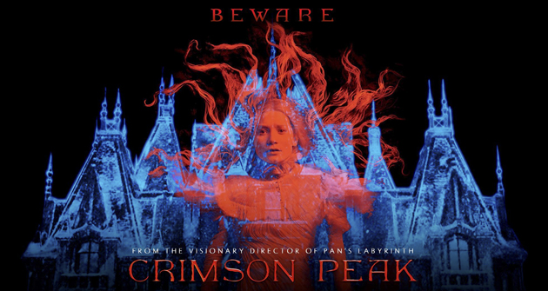
Movies: Supernatural events, focus on old houses
The Shining
Crimson Peak

Slide 10
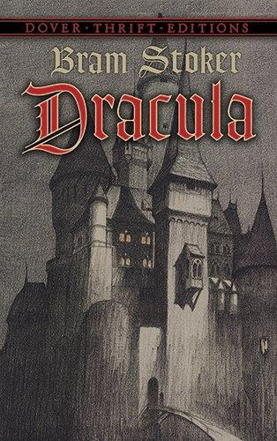
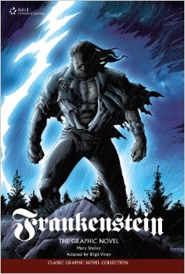
Books: The Classics
Dracula
Frankenstein

Slide 11
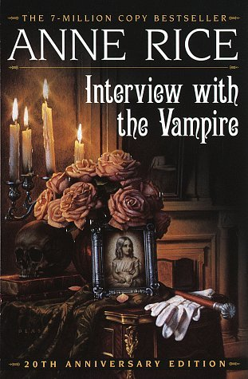
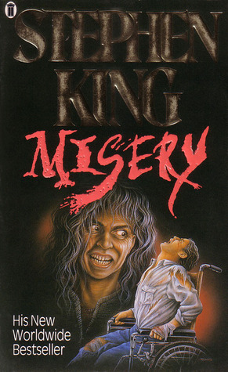
Modern Books:
Interview with a Vampire
Most Stephen King books

Slide 12
Allegory: Split Level Stories
An allegory is a story in which characters, settings and actions stand for something beyond themselves.
In some types of allegories, the characters and setting represent abstract ideas of moral qualities.
In other types, characters and situations stand for historical figures and events.

Slide 13
Allegories
An allegory can be read on one level for its literal or straightforward meaning
And on a second level for its symbolic, or allegorical, meaning.
Allegories are often intended to teach a moral lesson or to make a comment about goodness and vice.

Slide 14
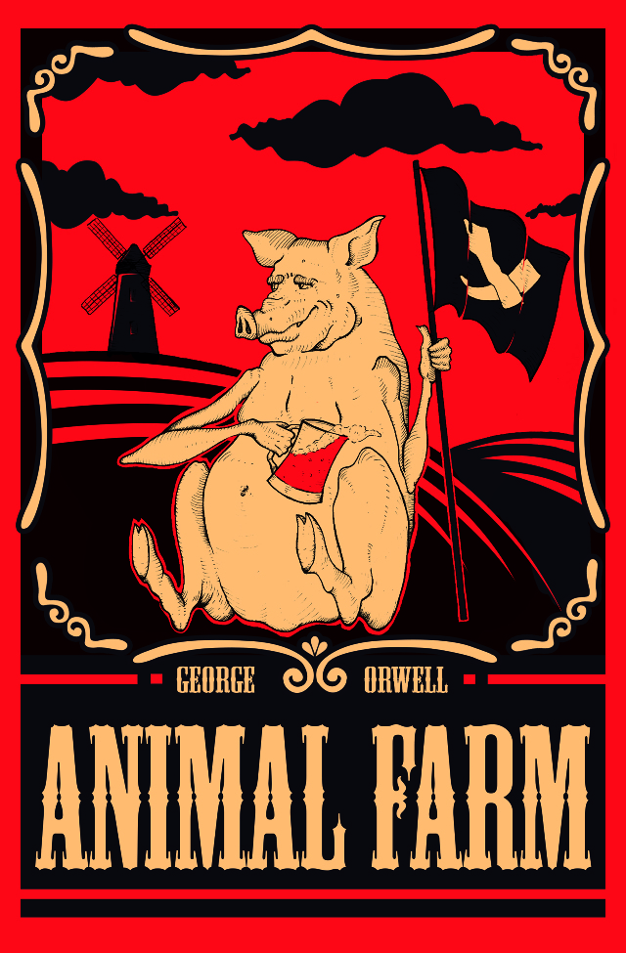
Famous Example: Animal Farm by George Orwell
On one level it is the story about pigs and other farm animals plotting to rise against their farmer, Mr. Jones.
However, it is really about Bolshevik Revolution in Russia in 1917 and the rise of the Soviet Union and communism.

Slide 15
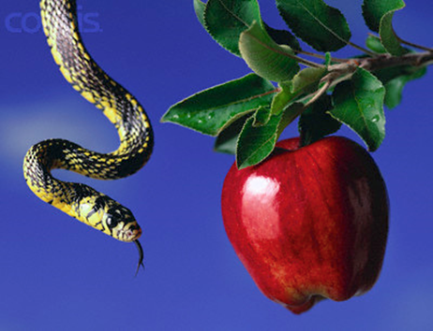
More Allegories
Here we have a picture of a serpent (snake) and an apple.
What are some things that come to mind when you see this image?
Often times, a serpent or snake is used to symbolize temptation or trouble. This allegory stems from it’s biblical reference.
What does the apple stand for?

Slide 16
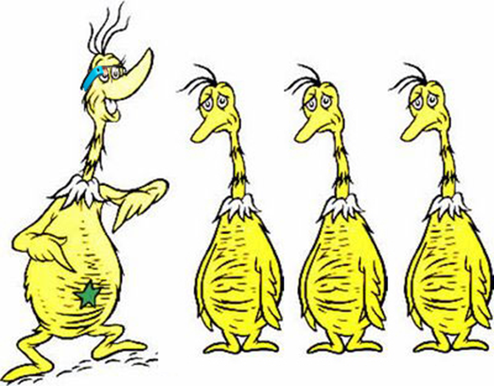
“Star Bellied Sneetches” by Dr. Seuss
As you watch this children’s story please come up with an allegorical interpretation of the story. Jot these ideas down in your notes.
https://www.youtube.com/watch?v=eBCUkdd57qc

Slide 17
Sneetches Allegory
Think back to all the times humans have discriminated against people because of the way they look. One example we will point to: Jewish people, who were made to wear stars (yep, stars) to distinguish themselves through various periods in history. Because "The Sneetches" was first published in 1961, during the Civil Rights Movement, it’s a pretty safe bet to assume that issue was on Seuss’ mind.

Slide 18
Poe Story Options
For continued practice with symbolism and allegory, you will read another short story by Poe.
You get to select your story from the 8 other options in our books.
As you read your story, you need to take note of any symbolism you detect as you will need to reflect on this for your reading assignment.

Slide 19
“Ligeia” (1838)
Follows an unnamed narrator and the events of his first wife, Ligeia and his second wife, Rowena slowly dying and the events that follow.
Is it all just an opium-induced hallucination?

Slide 20
“The Fall of the House of Usher” (1839)
Follows an unnamed narrator and the events that unfold after he arrives at the house (scary, old mansion) of his friend, Roderick Usher. The narrator is worried after he received a letter from Roderick complaining of an illness that has inflicted him and his twin sister, Madeline.
What will be the fate of this family?

Slide 21
“The Murders in the Rue Morgue” (1841)
Considered to be the first modern detective story.
As the first fictional detective, the main character displays many traits which became literary conventions in subsequent fictional detectives, including Sherlock Holmes.
Is the man who is arrested for the murder actually guilty?

Slide 22
“The Pit and the Pendulum” (1842)
An unnamed narrator describes his experience of being tortured as a prisoner of the Spanish Inquisition.
This story has a heavy focus on the senses to inspire fear emphasizing reality more than the supernatural; a departure for Poe.
Will the narrator escape this terrible fate?

Slide 23
“The Tell-Tale Heart” (1843)
An unnamed narrator attempts to convince the reader of his sanity while describing a murder he has committed.
What is the motivation for the murder? Will the narrator convince you he is sane?

Slide 24
“The Gold-Bug” (1843)
An unnamed narrator visits his friend William Legrand, who was bitten by a gold-colored bug. Legrand’s servant Jupiter, fears he may be going insane from the bite. The three embark on an adventure that requires deciphering secrets messages and searching for buried treasure.
The story involves cryptography with a detailed description of a method for solving a simple substitution cypher. Will this lead our main characters to treasure or misfortune?

Slide 25
“The Black Cat” (1843)
An unnamed narrator attempts to convince us of his innocence as he describes a murder he has committed.
Our narrator has a close relationship with a large black cat named Pluto who will be a main character throughout the story.
Did he do it? What’s with the cat?

Slide 26
“The Cask of Amontillado” (1846)
Set in an unnamed Italian city, a man named Montresor takes revenge on his friend who he believes has insulted him.
How far will Montresor take his revenge? Why is there so much wine in this story?

Slide 27
Gothic and Allegory Assignment
Create a symbols chart. The symbols chart should identify at least 5 symbols that occur (and maybe reoccur) throughout the story.
Once you have your symbols chart completed, respond to the following question in at least 5 sentences using your symbolism as your evidence. What might this Poe short story be an allegory for? What is the lesson or comment Poe is making with this allegory?
Remember, in some types of allegories, the characters and setting represent abstract ideas of moral qualities and are often intended to teach a moral lesson or to make a comment about goodness and vice.
Symbol | Possible Meaning

